Slide 1

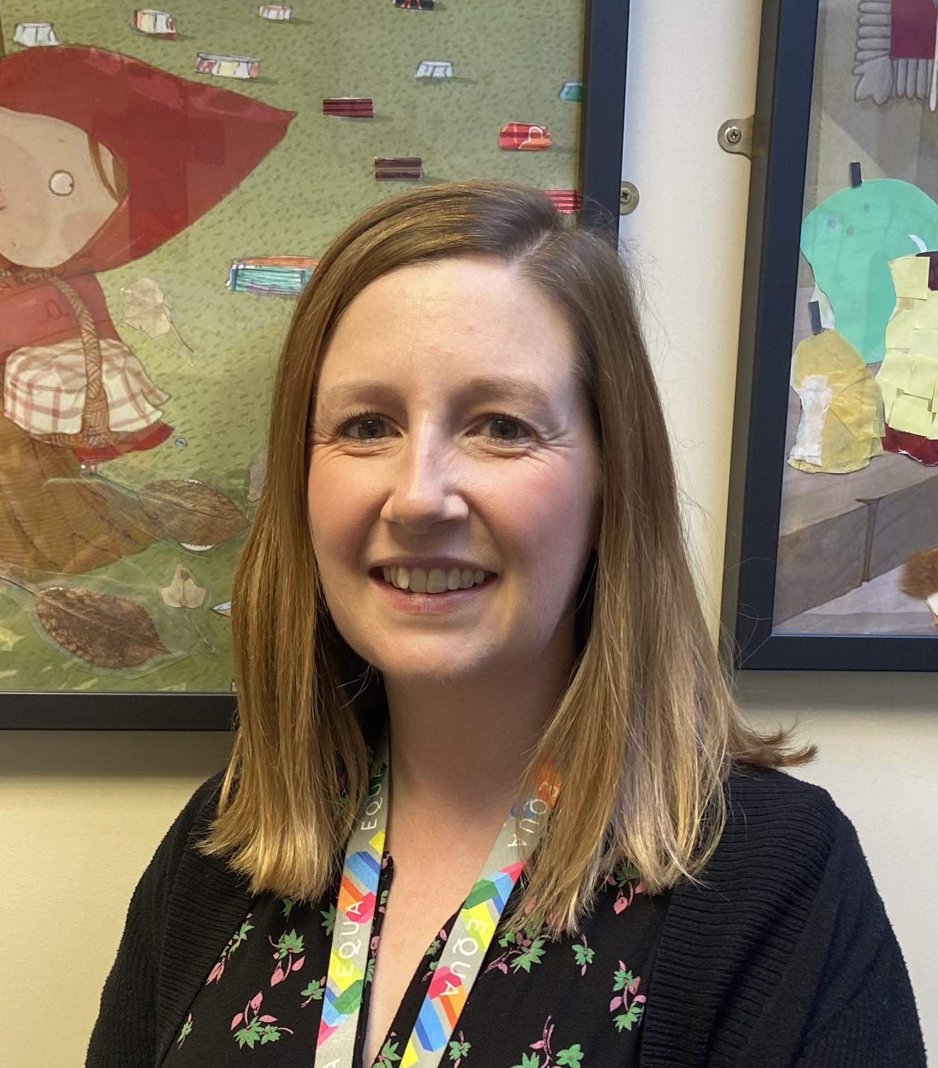
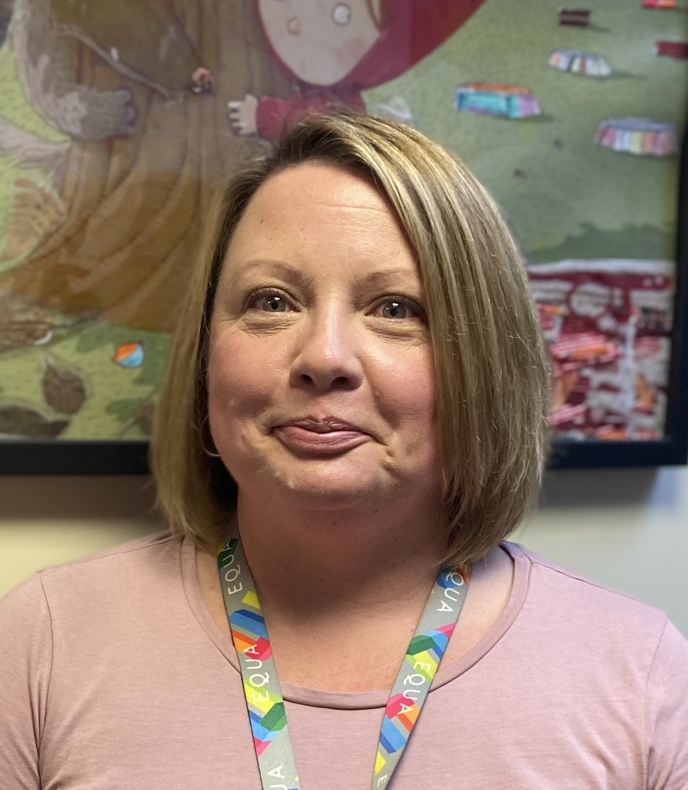
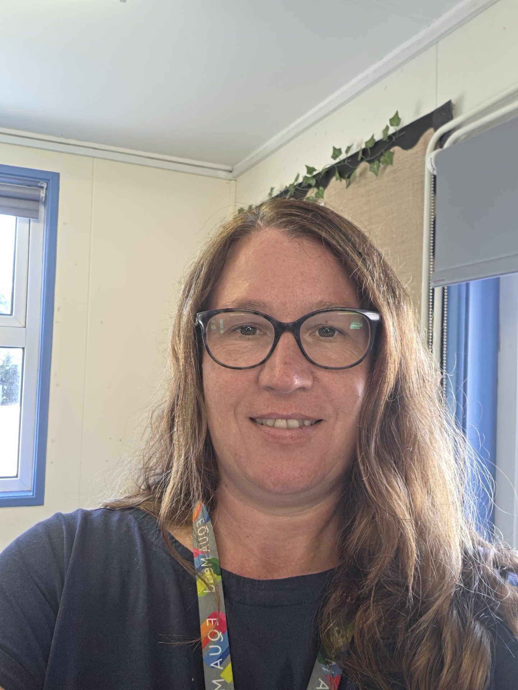
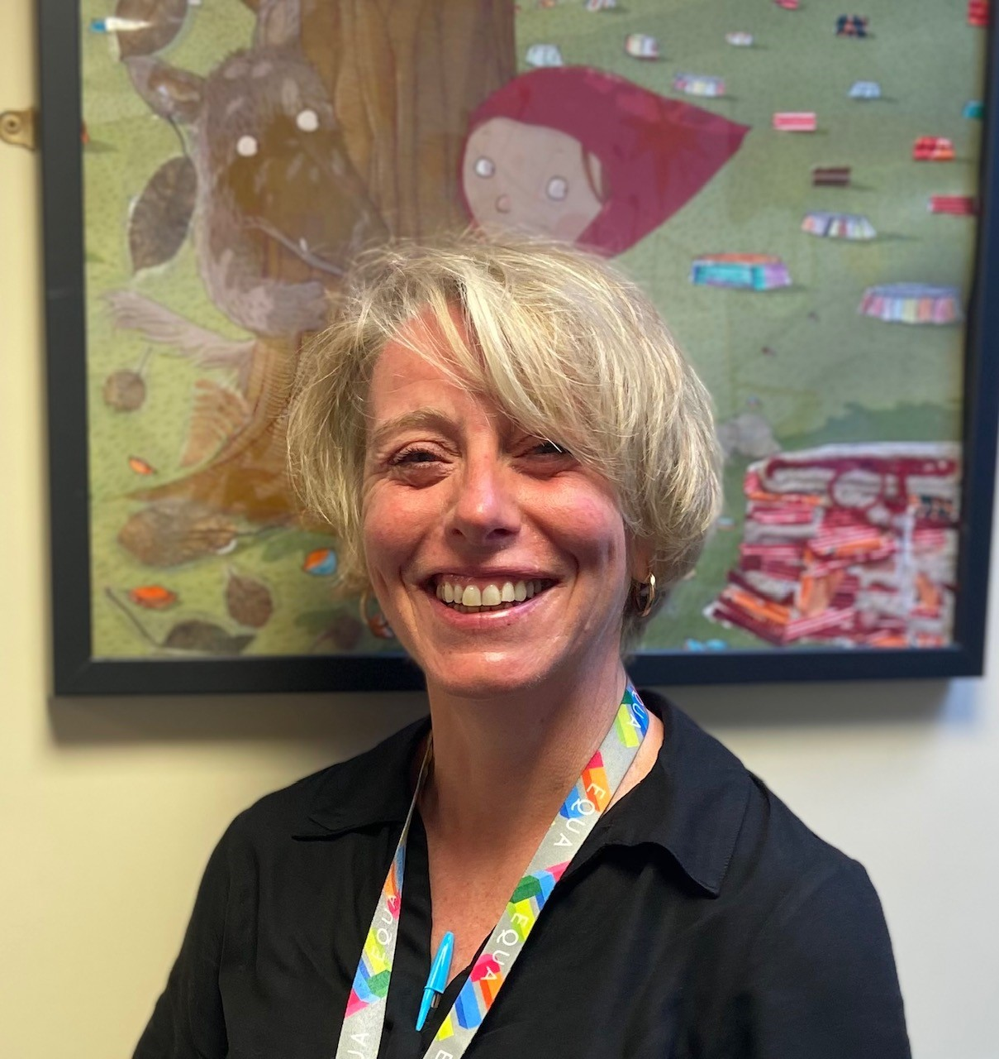

If something doesn’t feel right tell somebody, in a safe way.
Use your voice
Not feeling safe
Something is worrying you
Seeing someone else not being happy
Wanting help with something
Not feeling listened to
Something’s making you feel uncomfortable
Something’s just not right
Who can I talk to…..
Mrs Wren | Mrs Parry
Mrs Johanson | Mrs McCormick
or any other trusted adult
It’s good to talk

